Slide 1

CLOUD TECHNOLOGIE
FOODAPP
ALHAZ MULTANI

Slide 2
Introducing Our Application
FoodApp
FoodApp is a web application designed to manage food items. It provides functionalities for storing and displaying information about various food items, facilitating easy management for users.

Slide 3

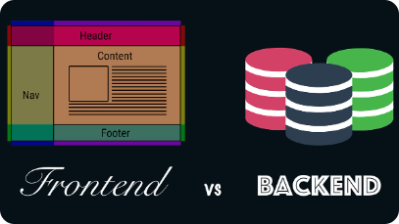
Technical Details
1
Frontend:
2
Backend:
HTML, CSS, and Razor syntax are used to create dynamic web pages.
ASP.NET Core MVC framework is used for server-side scripting.
Bootstrap framework ensures a clean and responsive design.
Entity Framework Core with Pomelo.EntityFrameworkCore.MySql is utilized for database operations..

Slide 4



Features
User-Friendly Interface:
Food Item Management:
Database Integration:
The application provides a user-friendly interface built using ASP.NET Core MVC.
Users can add new food items with details such as name and description.
Food items are stored in a MySQL database, ensuring data persistence and reliability.
It's responsive, allowing users to access it from any device.
Entity Framework Core is used for database access and management.

Slide 5
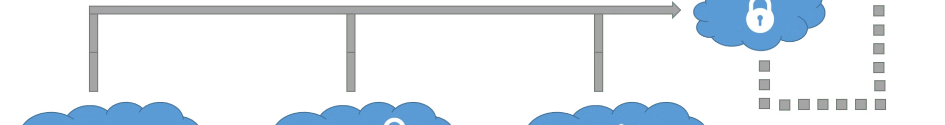
Deploying to the Cloud
Azure Container Instances (ACI):
Public Access:
The application is deployed to Azure Container Instances (ACI), providing scalability and flexibility.
The application is accessible via the provided url foodiweb.azurewebsites.net
Docker containers are used for packaging the application.
Users can interact with the application through their web browsers.
1
2
3
Database Setup:
A MySQL database is hosted on Azure, storing food item information.
Migration files are used to manage the database schema.

Slide 6
Conclusion
Our food application may now be found under This link and is available to the public.
foodiweb.azurewebsites.net
Thank You

